Slide 1

K.S. SCHOOL OF BUSINESS MANAGEMENT
Gujrat University campus, Ahmedabad
Students Name :-
No. | NAME | Roll No.
1 | MAHERIYA SANDIP | 3116
2 | PARGHI JAYDIP | 3136
3 | RADADIYA DHRUV | 3172

Slide 2
Intellectual property and competition law
SURVEY
INTELLECTUAL PROPERTY RIGHTS
COMPETITION LAW
AIM
CONFLICT BETWEEN THE OBJECTIVES OF BOTH LAWS
INTELLECTUAL PROPERTY RIGHTS IN COMPETITION ACT
SECTION 3 OF SUB SECTION (5)
REASONABLE CONDITIONS
UNREASONABLE CONDITIONS (ANTI-COMPETITIVE)
CASE STUDY

Slide 3
SURVEY
Intellectual Property Rights and Competition Law have been described as an unhappy marriage.

Slide 4

INTELLECTUAL PROPERTY RIGHTS
legal rights granted to creators and owners of works that are results of human intellectual creativity. This can be in any field like industrial, scientific, literary and artistic. It gives the owners the right to exclude others from access to or the use of protected subject matter for a limited period of time. This also gives them the subsequent right to license others to exploit the innovation when they themselves are unable to engage in large-scale commercial exploitation or for other reasons.

Slide 5
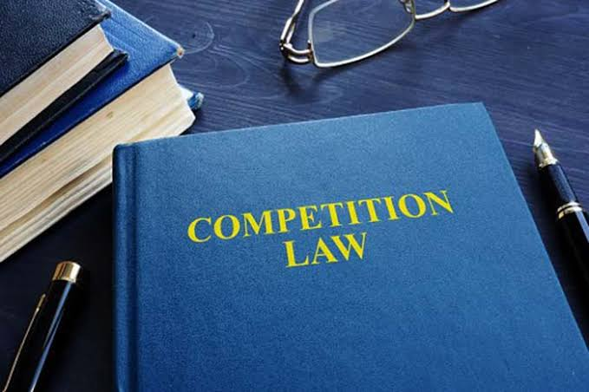
COMPETITION LAW
Competition law prevents artificial entry barriers and aims to remove monopolization of the production processes by encouraging entrance into industries by new players. The objectives of competition law include the maximization of consumer and producer welfare, as well as maximizing efficiency in production.

Slide 6
AIM
competition law aims at eliminating monopolization of the production process thereby encouraging new firms to enter into the market. The maximization of consumer welfare and an increase in production value are some of the main objectives of competition law.
IP Laws are monopolistic legal rights granted to the creators and owners of work which are a result of human intellectual creativity. These can be in varied fields such as industrial, scientific, literary and art.

Slide 7
CONFLICT BETWEEN THE OBJECTIVES OF BOTH LAWS
Intellectual Property (IP) Laws aim at protecting the research and development inventions carried out by inventor firms from being used by companies producing similar products and subsequently making a profit on the same. In other words, on one hand, IP laws work towards creating monopolistic rights whereas competition law battles it. In view of this there seems to be a conflict between the objectives of both laws.

Slide 8
INTELLECTUAL PROPERTY RIGHTS IN COMPETITION ACT
The Indian competition law, deals with the applicability of section 3 prohibition relating to anti-competitive agreements to IPRs. An express provision [section 3 of sub section(5)] is incorporated in the Act that reasonable conditions as may be necessary for protecting IPRS during their exercise would not constitute anticompetitive agreements. In other words, by implication, unreasonable conditions in an IPR agreement that will not fall within the bundle of rights that normally form a part of IPRs would be covered under section 3 of the Act.

Slide 9
SECTION 3 OF SUB SECTION (5)
"Nothing contained in this section shall restrict - (i) the right of any person to restrain any infringement of, or to impose reasonable conditions, as may be necessary for protecting any of his rights which have been or may be conferred upon him under:
(a) the Copyright Act, 1957 (14 of 1957);
(b) the Patents Act, 1970 (39 of 1970);
(c) the Trade and Merchandise Marks Act, 1958 (43 of 1958) or the Trade Marks Act, 1999 (47 of 1999);
(d) the Geographical Indications of Goods (Registration and Protection) Act, 1999 (48 of 1999);
(e) the Designs Act, 2000 (16 of 2000);
(f) the Semi-conductor Integrated Circuits Layout-Design Act, 2000 (37 of 2000).'

Slide 10
REASONABLE CONDITIONS
The expression "reasonable conditions" has not been defined or explained in the Act. However, by implication, unreasonable conditions that attach to an IPR will attract section 3. In other words, licensing arrangements likely to affect adversely the prices, quantities, quality or varieties of goods and services will fall within the contours of competition law as long as they are not reasonable with reference to the bundle of rights that go with IPRs.

Slide 11
UNREASONABLE CONDITIONS (ANTI-COMPETITIVE)
PATENT POOLING (LOCKING TECHNOLOGY)
TIE-IN ARRANGEMENTS (ACQUIRE PARTICULAR GOODS SOLELY FROM PATENTEE)
ROYALTY PAYMENT AFTER EXPIRY OF PATENT
PROHIBIT LICENSEE TO USE RIVAL TECHNOLOGY
PROHIBIT LICENSEE FROM CHALLENGING VALIDITY OF IPR
FIXING PRICES FOR THE LICENSEE TO SELL
TERRITORIAL AND CUSTOMER RESTRICTION

Slide 12
Hawkins Cookers Limited v M/s MurungaN Enterprises
Justice Kaul also pointed out that "The object of filing of the suit thus appears to be to create a monopoly over such (gaskets) ancillary items so that no third party is able to sell the same in the market." The judge also goes on to point out that the use of the “Hawkins” trademark on the gaskets packaging would have been infringing if it had been used as a trademark. Since Murungan Enterprise's use of the "Hawkins" mark was only indicative and is not being used as a trademark there would be no question of infringement.

Slide 13
CASE STUDY
Co X with 75% of domestic biscuit market proposed a merger with Co Y, which had 15% market share of biscuit market.
Justification given for the merger : "Snacks" and NOT "Biscuits" is the relevant market. In the snacks market, Co X had a 10% share of the market and Co Y, a mere 1%.
HELD : the relevant market was "biscuits" and not "snacks". merger not allowed..

Slide 14
Thank you

